Slide 1


Project Presentation on “PATH FINDER” By: Arjun H N Karthik Kumar H Varun K Murthy
By: Guided By:
Arjun HN Mr. Kishore G R
Karthik Kumar H Asst.Professor
Varun K Murthy ISE Department

Slide 2
Agenda:
Introduction
Project scope
Design
Mechanism
Applications
Advantage and Disadvantages
Future Scope

Slide 3
INTRODUCTION
“PATH FINDER” is a routing optimization algorithm.
Whenever a network experiences a node or a link failure the pre-existing optimal path needs to be entirely changed.
The proposed system tries to solve this issue by computing a set of optimal paths.
In case of node or link failure incurring minimum cost in terms of bandwidth and processor time and space.

Slide 4
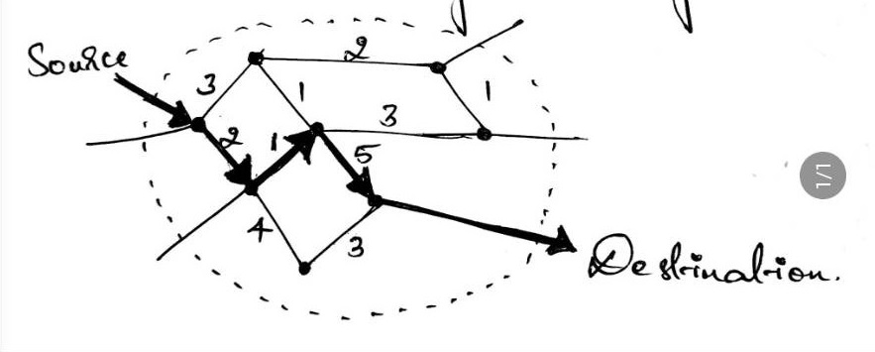
Interdomian routing in IP networking follows shortest path according to administrative link costs.
When several equal-cost shortest paths exists, routers that use equal-cost multipath(ECMP) distribute the traffic over all of them.

Slide 5
Design
Whenever a node or link fails ,the system finds alternate route to send the packets.
The system provides shortest path algorithm for nodes in a network.
It finds the error in the link or node.
First it detects the error or a node failure in a network.

Slide 6
Design
Then the pre-existing optimal path needs to be entirely changed.
Then system finds optimal route to any given node to reach the destination.
The packets in a given network will follows the minimum cost path reaches the destination.
In case of node or link failure incurring min cost in terms of bandwidth and processed time and space.

Slide 7
Methodology
“Arka” works under the principle of multi-path routing and flooding under node failure.

Slide 8
ARKA-Genesis
Why there is a need for newer algorithm?
How is “Arka” different from other flooding algorithms?

Slide 9
ARKA-The algorithm.
Finding the neighbors.
Check distances.
Checking the connectivity .

Slide 10
ARKA-The algorithm
Group based on connectivity
Checks the connectivity matrix.
Route.

Slide 11
Time complexity
ARKA is compared with the existing algorithms.
It consumes a very low run time for any network having nodes more than 3 in number.

Slide 12
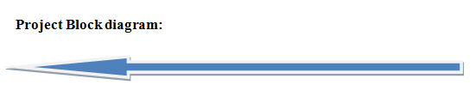
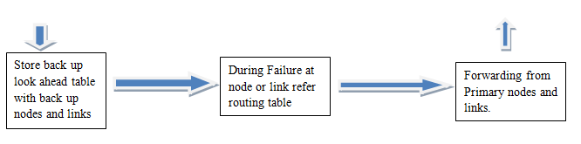

Slide 13
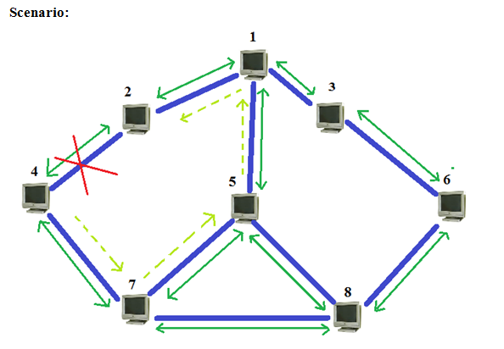
Figure: Network showing a link failure
The figure 1.1 represents 8-node network where links are represented by blue lines and path by green lines. Here an example of sending packets from 1 to 7 is considered. When the link 4 fails it routes packets from backup node to 7. Or if the next node itself is destination then it loops back the packets.

Slide 14
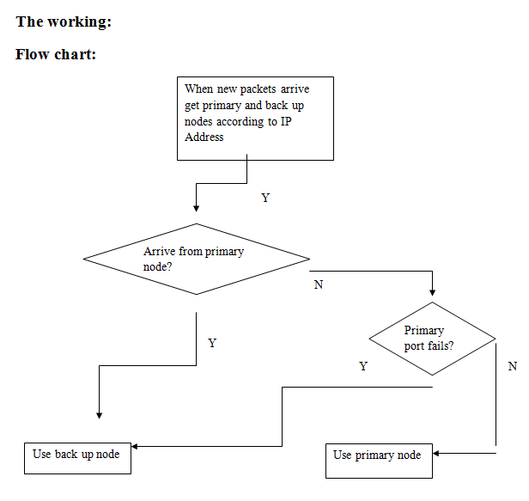

Slide 15
Single link failure recovery: When a failure occurs, a subset of the nodes switch to their backup ports for fast rerouting, and the set of forwarding paths are changed accordingly. The rerouting is correct if and only if the new set of forwarding paths still form a spanning tree with node 1 as the root.
Single node recovery: Single-node failures are different from single-link failures in that the failure of a node disables all the links directly connected to it. Consequently, several sub-trees could be detached from the primary tree.

Slide 16
Application of the project: For all Internet Applications (e.g.: during online credit transactions and in security management network failure causes significant loss and hence there should be explicit/spontaneous recovery).
In Business Applications where time plays critical role. It becomes extremely necessary and useful in guaranteed service networks. Also enhances the performance of best effort service networks.

Slide 17
Advantages
Multiple Routing Configurations (MRC) is a proactive and local protection mechanism that allows recovery in the range of milliseconds.
MRC allows packet forwarding to continue over preconfigured alternative next-hops immediately after the detection of the failure.

Slide 18
Disadvantages
This network-wide IP re-convergence is a time consuming process and a link or node failure is typically followed by a period of routing instability. During this period, packets may be dropped due to invalid routes.
The IGP convergence process is slow because it is reactive and global. It reacts to a failure after it has happened. For the existing system global routing information is needed.

Slide 19
Future Scope
To make the learning faster.
To make the clustering parameters intelligent.
Reduce load on IP.

Slide 20


